Slide 1

Kettu
PERSONALIZED RECOMMENDATIONS FOR FOOD, COFFEE, AND EVENTS.
BUILT FOR PEOPLE IN UZBEKISTAN WHO WANT FAST, RELEVANT SUGGESTIONS.
MAY 2025
TASHKENT

Slide 2

the problem
MOST PEOPLE DON’T WANT TO SCROLL THROUGH GOOGLE MAPS OR OUTDATED REVIEW SITES.
THEY JUST WANT TO KNOW:
WHERE SHOULD I GO RIGHT NOW?
CEO – KAMILLA JURAEVA

Slide 3

solution
WE CREATE TELEGRAM BOT WITH AI RECOMENDATIONS BASED ON YOUR:
PREFERENCES
LOCATION
TIME OF THE DAY

Slide 4

how it works
YOU WRITE: “I WANT FOOD” OR “I WANT TO GO OUT”
YOU SET YOUR MOOD OR TYPE (E.G. COFFEE, DINNER, CONCERTS)
YOU SEND YOUR LOCATION
KETTU SENDS 3–5 PERSONALIZED RECOMMENDATIONS
EACH SUGGESTION INCLUDES:
RATING & DISTANCE
PHOTOS & REVIEWS
MAP & DIRECTIONS
BOOKING LINKS

Slide 5
target audience
AGE:
18-40
LOCALS, TOURISTS, GROUPS AND COUPLES
PEOPLE:
LOCATION:
TASHKENT
(2)
WHO IS THIS
intended for?

Slide 6
target segments
TAM
Total Addressable Market
All people in Uzbekistan + tourists
~45 mln people
SOM
Serviceable Obtainable Market
Urban Telegram users actively seeking places to eat and go out
~20 mln people
SAM
Serviceable Obtainable Market
Active people at age 15-40, who live in Tashkent
~ 300.000 people

Slide 7

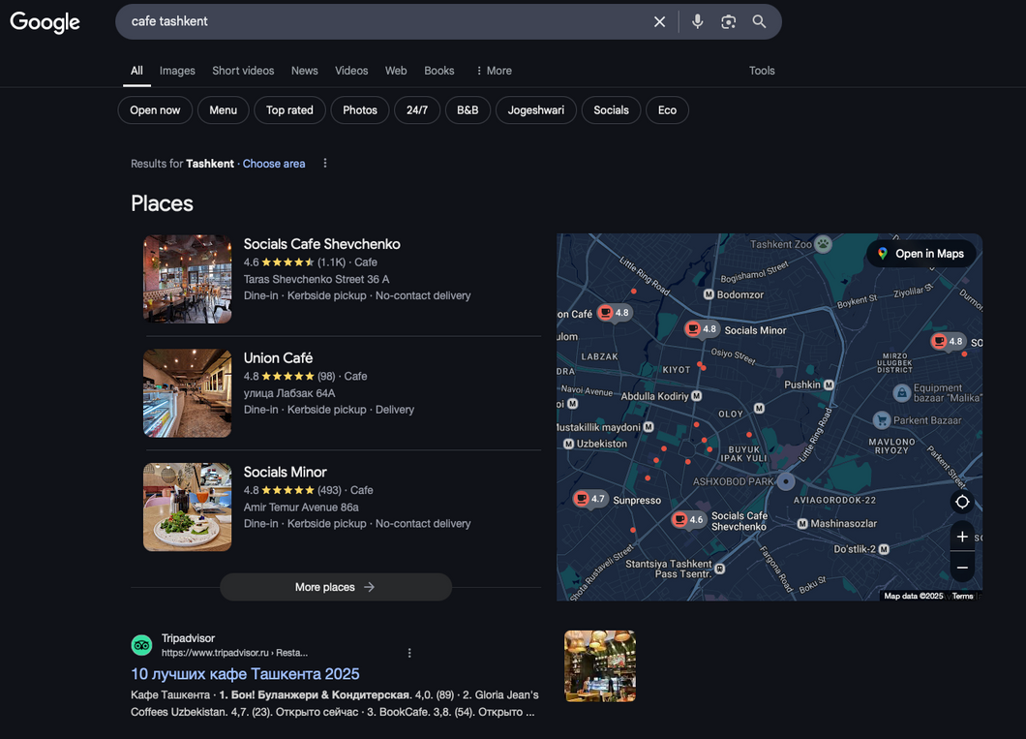
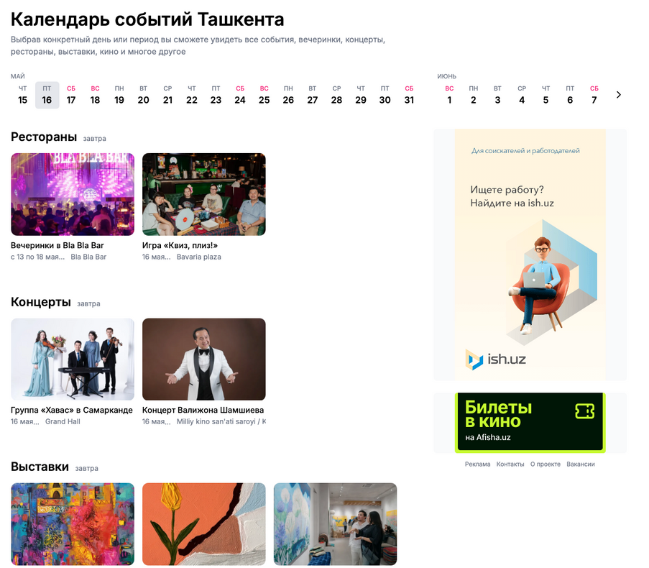
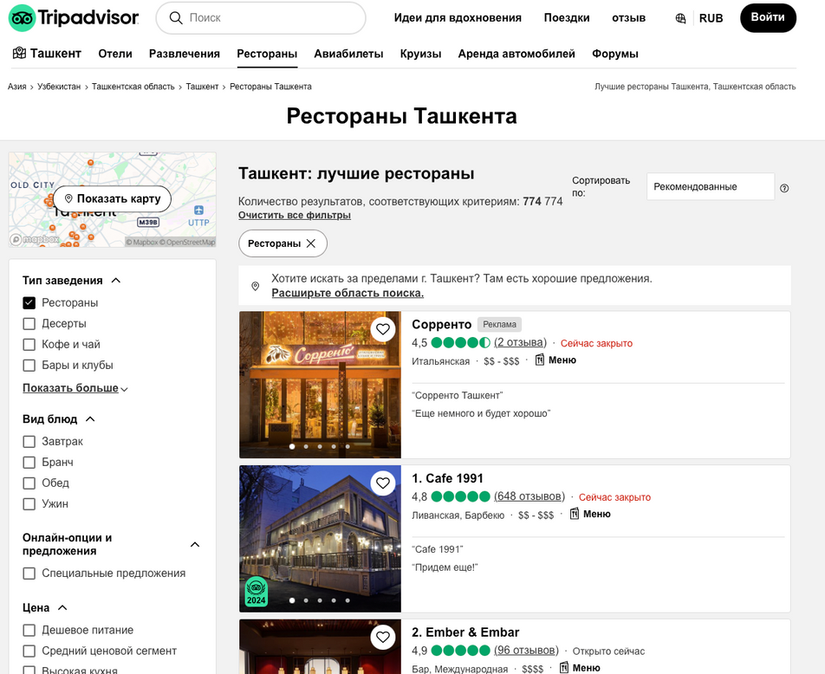

Slide 8
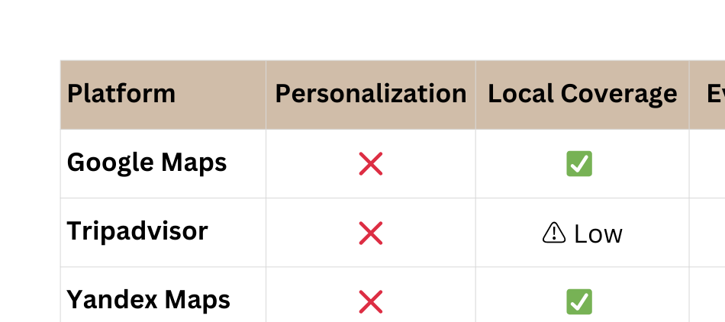
our competitors

Slide 9
Our Vision & Brand Purpose
CMO - ELBEK ERKINBOEV

Slide 10
Kettu
YOUR SMART LIFESTYLE COMPANION
AT KETTU, WE ENVISION A WORLD WHERE MANAGING YOUR DAY FEELS EFFORTLESS AND EMPOWERING.
WE’RE BUILDING MORE THAN JUST AN APP — WE’RE CREATING A TOOL THAT HELPS USERS ORGANIZE, PRIORITIZE, AND THRIVE.
CMO - ELBEK ERKINBOEV

Slide 11
We aim to become the most intuitive and trusted personal productivity app for young, modern users worldwide.

Slide 12

Marketing Strategy & Positioning
WHO WE TARGET:
STUDENTS, YOUNG PROFESSIONALS, DIGITAL NATIVES
AGED 18–35, TECH-SAVVY, TIME-CONSCIOUS
HOW WE REACH THEM:
SOCIAL MEDIA MARKETING (TIKTOK, INSTAGRAM REELS)
CAMPUS AMBASSADOR PROGRAMS
INFLUENCER PARTNERSHIPS (MICRO-CREATORS IN PRODUCTIVITY/WELLNESS)
APP STORE OPTIMIZATION (ASO) & SEO CONTENT

Slide 13
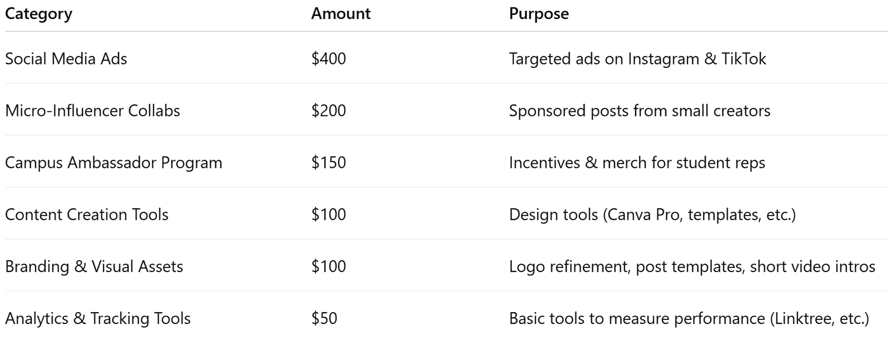
Marketing Budget Plan (Initial Phase)
LEAN BUT IMPACTFUL — WE FOCUS ON CHANNELS WITH THE HIGHEST ROI FOR OUR NICHE AUDIENCE.

Slide 14

KPIs & Success Metrics
WE’LL TRACK KEY PERFORMANCE INDICATORS TO MEASURE GROWTH:
App Installs & Cost per Acquisition (CPA)
User Retention (Day 1, Day 7, Day 30)
Active Daily & Monthly Users (DAU / MAU)
Social Media Engagement (shares, saves, comments)
App Store Ratings & Reviews
Data guides our decisions. We optimize, scale, and repeat.

Slide 15
Future Growth & CMO Vision
WHAT’S NEXT FOR KETTU?
Launch premium features (AI recommendations, integrations)
Scale marketing across new regions with localization
Partner with wellness brands and tech creators
Expand into new verticals: journaling, habit tracking, mental clarity
AS CMO, I AIM TO:
Craft a memorable brand identity
Drive authentic community growth
Balance creativity with data-driven marketing
Lead KETTU to become a global productivity brand
Let’s not just launch an app — let’s start a movement.

Slide 16
Building the Tech Foundation
CTO – RAVSHAN ZARIPOV

Slide 17
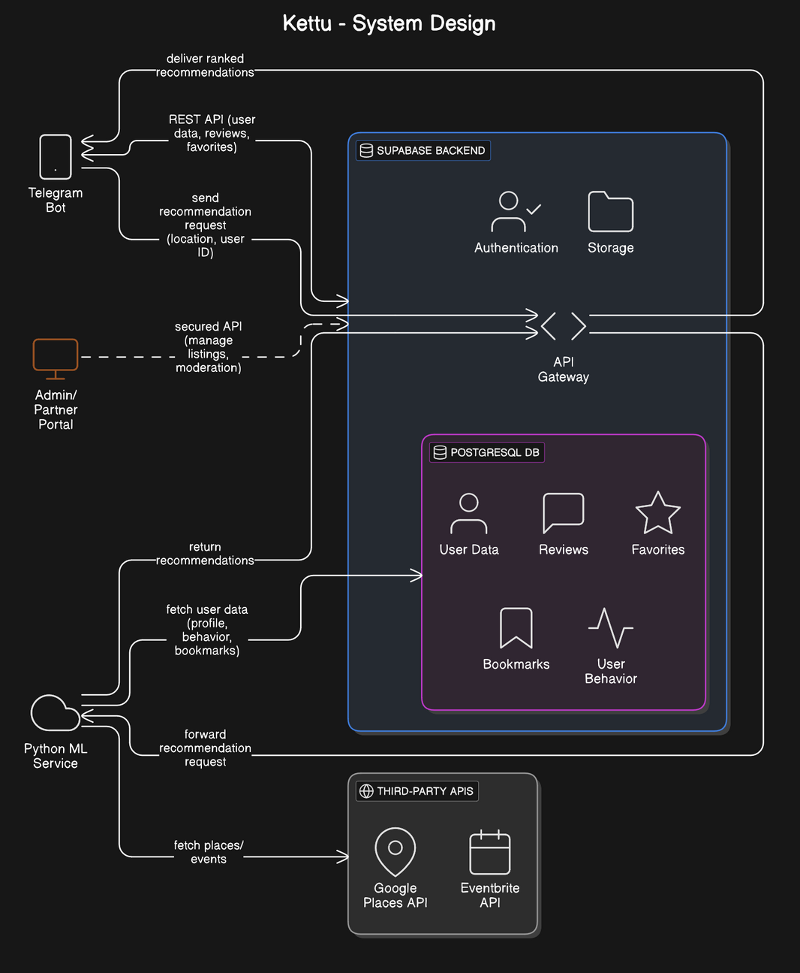
CTO – RAVSHAN ZARIPOV

Slide 18
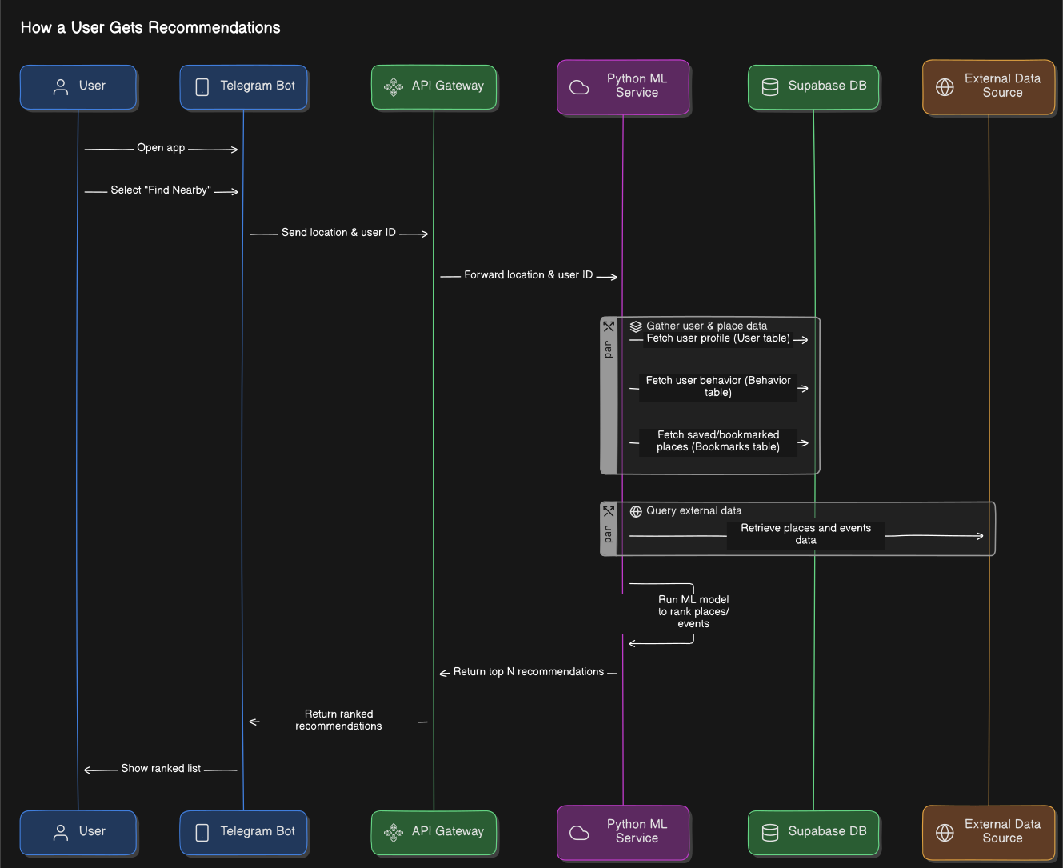

Slide 19
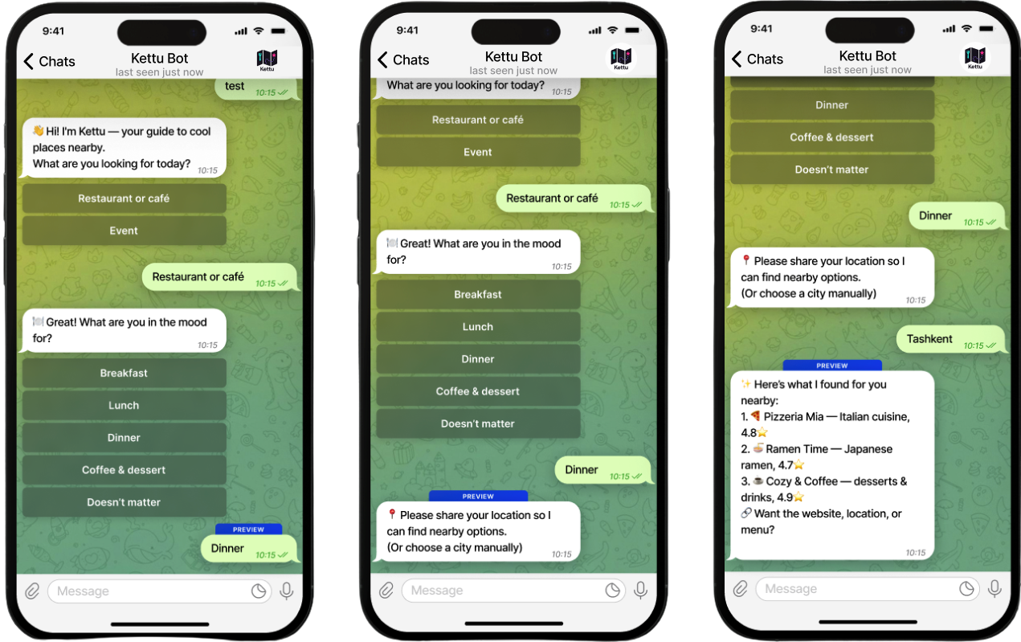

Slide 20
Business model
RESTAURANT PROMOTION SUBSCRIPTION
PREDICTABLE REVENUE FOR US; PREDICTABLE SPEND FOR RESTAURANTS
NO NEED FOR PER-BOOKING INVOICING OR AD-TECH KNOW-HOW
BOOSTED VISIBILITY DIRECTLY SOLVES VENUES’ PAIN POINT (FOOT-TRAFFIC).
RESTAURANTS PAY EITHER SUCCESS-BASED (PER COVER) OR VISIBILITY-BASED (SUBSCRIPTION), MAXIMIZING UPTAKE.
MARKETPLACE MODEL
KETTU CONNECTS TWO SIDES — USERS AND VENUES. THE PLATFORM LOGIC IS THE PROJECT’S BACKBONE.
FREE BASIC LISTINGS CREATE CRITICAL MASS OF CONTENT.
OTHER REVENUE STREAMS (COMMISSION, ADS) PLUG NATURALLY INTO THE MARKETPLACE.
AD‑BASED
LOCAL CAFÉS, EVENT AGENCIES AND DELIVERY SERVICES HAVE GROWING DEMAND FOR TARGETED ADS.
• BANNER AND SPONSORED CARDS
• NATIVE PROMO POSTS AND PUSH CAMPAIGNS ON A CPC/CPM BASIS
• QUICK INTEGRATION VIA GOOGLE ADMOB OR AN IN‑HOUSE AD SERVE.
CFO – DANIEL KAPRANOV

Slide 21
Adds & Subscription
IN APP ADS
SPONSORED BANNER
ONE-OFF PROMOTION
24-HOUR “BOOST”
SLOT
MONTHLY SUBSCRIPTION
TOP PLACEMENT
FOR A MONTH
$3
$25
$49

Slide 22
Funding
1. IT PARK UZBEKISTAN – “DIGITAL STARTUPS” GRANTS + IT PARK VENTURES FUND
WHY?
2. LOCAL ANGELS & PRE-SEED ROUND
(UZVC, ALOQAVENTURES, SEMURG.VC, PRIVATE ANGELS)
WHY?
• FLAGSHIP NATIONAL PROGRAM;
TAILORED FOR EARLY-STAGE TECH IN TASHKENT.
• MONEY ARRIVES FAST, ZERO OR LOW EQUITY LOSS.
• COMES WITH FREE COWORKING, CLOUD CREDITS AND PR SUPPORT.
• UZBEKISTAN’S ANGEL NETWORK AND 15+ ACTIVE MICRO-VCS ARE NOW WRITING PRE-SEED CHEQUES (MEDIAN $200 K).
• INVESTORS BRING F&B CONTACTS AND MARKETING EXPERTISE; PERFECT FOR A VENUE-DRIVEN MARKETPLACE.
• FUNDING SIZE MATCHES OUR PROJECTED $250 K NEED FOR 18-MONTH RUNWAY.
CFO – DANIEL KAPRANOV

Slide 23
Costs
KEY MARKETING COSTS (YEAR 1)
PAID USER ACQUISITION (META, GOOGLE UAC, TIKTOK) ≈ $5 000
MICRO-INFLUENCER COLABS ≈ $5 000
REFERRAL INCENTIVES ≈ $3 000
CONTENT PRODUCTION ≈ $4 000
OFFLINE PROMO (MALLS, EVENTS) ≈ $3 000
ANALYTICS TOOLS ≈ $1 000
CONTINGENCY BUFFER ≈ $3 000
TOTAL: ≈ $24 000
KEY TECHNICAL COSTS (YEAR 1)
DEVELOPER SALARIES ≈ $17 000
CLOUD & API INFRASTRUCTURE ≈ $2 000
DEVOPS / MONITORING TOOLS ≈ $2 000
WORKSTATIONS ≈ $10 000
CONTINGENCY BUFFER ≈ $2 000
TOTAL: ≈ $33 000
KEY OPERATIONAL COSTS (YEAR 1)
CORE SALARIES – $18 000
CUSTOMER-SERVICE REPS – $3 000
OFFICE & UTILITIES – $7 000
OPS SOFTWARE & TOOLS – $1 500
TRAVEL & PARTNER OUTREACH – $1 500
CONTINGENCY BUFFER – $2 000
TOTAL ≈ $33 000
CFO – DANIEL KAPRANOV
FINAL TOTAL COST FOR THE FIRST YEAR IS $90 000

Slide 24
Financial projection
YEAR-1 — KEY METRICS (BASELINE ≈ 10 K MAU)
GROSS REVENUE: $104K
ADS $67K
COMMISSIONS $12K
VENUE SUBS $18K
PREMIUM USERS $7K
AVERAGE REVENUE PER ACTIVE USER (ARPU): $0.87 / USER / MONTH
CUSTOMER-ACQUISITION COST (CAC): $4.40
LIFETIME VALUE (LTV, 12-MO HORIZON): $10.4
⇒ LTV / CAC ≈ 2.3 (HEALTHY > 2)
PAYBACK PERIOD: ≈ 5 MONTHS (CAC ÷ MONTHLY ARPU)
TOTAL OPERATING EXPENSES : $141 K

Slide 25
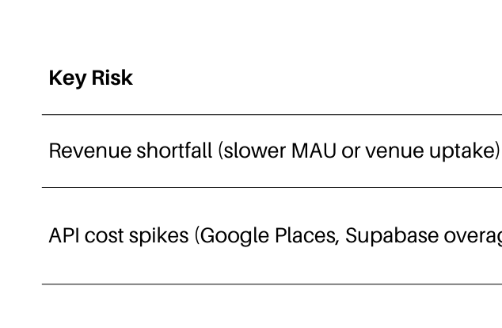
Risks and Mitigation

Slide 26
here, the operations run on Bobur*
“I TURN BIG DREAMS INTO DAILY DELIVERABLES”
I TURN OUR VENUE BOT INTO A SMOOTH, EVERYDAY COMPANION—SO USERS SPEND LESS TIME SEARCHING AND MORE TIME ENJOYING THE RIGHT PLACE.
COO - BOBUR IBRAGIMOV

Slide 27
My Day-to-Day
Ensuring Operational Excellence
OVERSEEING DAILY OPERATIONS AND OPTIMIZING BUSINESS EFFICIENCY.
MANAGING WORKFLOWS, RESTAURANT PARTNERSHIPS, AND EVENT LOGISTICS.
IMPLEMENTING DATA-DRIVEN PERFORMANCE TRACKING SYSTEMS.
✅ STREAMLINE OPERATIONS – DEVELOP EFFICIENT INTERNAL WORKFLOWS FOR RESTAURANT AND EVENT ONBOARDING.
✅ BUILD STRATEGIC PARTNERSHIPS – ESTABLISH LONG-TERM RELATIONSHIPS WITH RESTAURANTS, CAFÉS, AND EVENT ORGANIZERS.
✅ MEASURE & OPTIMIZE PERFORMANCE – IMPLEMENT KPIS TO TRACK SERVICE EFFICIENCY AND USER ENGAGEMENT.
DATA IN → CLEAN & VALIDATE → REFRESH MODEL → MONITOR → SUPPORT.

Slide 28
What’s Next
OVER THE NEXT SIX MONTHS
I WILL DOUBLE THE NUMBER OF TASHKENT AREA WE COVER,
CUT REPLY TIME IN HALF,
AND LAUNCH A ONE-CLICK PORTAL FOR VENUE OWNERS.
These steps make the bot faster for USERS AND EASIER FOR PARTNERS
—AND THEY PREPARE OUR PLATFORM FOR THE NEXT WAVE OF GROWTH.
Develop a standardized partner onboarding process – Create a clear step-by-step guide for restaurants to join the platform.
Implement a restaurant/event rating system – Ensure user-generated feedback is collected and analyzed to improve recommendations.
Set up automated support channels – Use chatbots or a simple ticketing system for user inquiries.
Ensure service reliability – Establish operational procedures to handle peak demand times.

Slide 29
Charting the Road Ahead
I BRIDGE OUR BIG-PICTURE VISION WITH DAILY DECISIONS —
ALIGNING PRODUCT, PARTNERSHIPS, AND GROWTH INITIATIVES.
CSO – NAJMIDDIN TOJEDDINOV

Slide 30
Strategic Pillars
WHAT DRIVES OUR GROWTH
✅ USER-CENTRIC EXPANSION
DOUBLE DOWN ON FEEDBACK LOOPS AND COMMUNITY ENGAGEMENT.
✅ SMART PARTNERSHIPS
SECURE DEALS WITH LOCAL ECOSYSTEMS — DELIVERY APPS, CITY GUIDES, DIGITAL WALLETS.
✅ SCALABLE INFRASTRUCTURE
ENSURE EVERY SYSTEM WE BUILD CAN HANDLE 10X GROWTH.
✅ GLOBAL-READY MINDSET
BUILD KETTU IN UZBEKISTAN, WITH FEATURES READY FOR ANY CITY.

Slide 31
Next Moves – Strategy Roadmap
LOCAL STRATEGIC ALLIANCES
Co-create value with malls, festivals, food apps, city tourism boards.
2. BENCHMARKING & COMPETITOR TRACKING
Build an intelligence loop to map our position in the region monthly.
3. PRODUCT DIFFERENTIATION PLAN
Push exclusive “Kettu-only” venue deals and AI-driven features.
4. STRATEGIC FUNDING READINESS
Prepare strategic narratives for Series A: value proposition, market wedge, long-term moat.

Slide 32
Kettu team
KAMILLA JURAEVA
ELBEK ERKINBOEV
RAVSHAN ZARIPOV
CEO
CMO
CTO
DANIEL KAPRANOV
BOBUR IBRAGIMOV
NAJMIDDIN TOJEDDINOV
CFO
COO
CSO

Slide 33
thank you

